Slide 1
Безопасность в Web

Slide 2

Agenda
Безопасность в HTTP
Встроенная
Основанная на
Single Sign-On
Протоколы
Токены

Slide 3
Безопасность на базе HTTP

Slide 4
Механизмы безопасности в (на базе) HTTP
 | Встроенные в HTTP | На базе HTTP
Аутентификация | Basic Digest Windows (Kerberos or NTLM) | Forms WS-Federation OAuth / OpenId …
Авторизация | - | Url-based User/Role-based
Шифрование | HTTPS (HTTP over SSL)

Slide 5
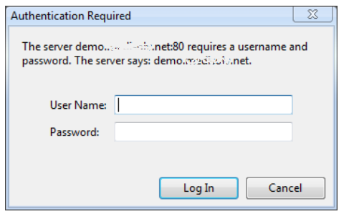
Встроенные: Basic Authentication
GET http://localhost/ HTTP/1.1
...
HTTP/1.1 401 Unauthorized
WWW-Authenticate: Basic realm=“localhst”
...
mihail:123
GET http://localhost/ HTTP/1.1
Authorization: Basic bWloYWlsOjEyMw==
...
bWloYWlsOjEyMw==
Небезопасно (без HTTPS)!!!

Slide 6
Встроенные: Digest Authentication
GET http://localhost/ HTTP/1.1
...
Username: "Mufasa",
Password: "Circle Of Life"
HTTP/1.0 401 Unauthorized
WWW-Authenticate: Digest realm="testrealm@host.com", qop="auth,auth-int", nonce="dcd98b7102dd2f0e8b11d0f600bfb0c093",
opaque="5ccc069c403ebaf9f0171e9517f40e41"
HA1 = MD5(username:realm:password) HA2 = MD5(method:digestURI) Response = MD5(HA1:nonce:nonceCount:cnonce:qop:HA2)
HA1 = MD5("Mufasa:testrealm@host.com:Circle Of Life")
= 939e7578ed9e3c518a452acee763bce9
HA2 = MD5( "GET:/dir/index.html" )
= 39aff3a2bab6126f332b942af96d3366
Response = MD5(
"939e7578ed9e3c518a452acee763bce9:\
dcd98b7102dd2f0e8b11d0f600bfb0c093:\
00000001:0a4f113b:auth:\
39aff3a2bab6126f332b942af96d3366" )
= 6629fae49393a05397450978507c4ef1
GET /dir/index.html HTTP/1.0
Authorization: Digest
username="Mufasa",
realm="testrealm@host.com",
nonce="dcd98b7102dd2f0e8b11d0f600bfb0c093",
uri="/dir/index.html",
qop=auth,
nc=00000001,
cnonce="0a4f113b",
response="6629fae49393a05397450978507c4ef1",
opaque="5ccc069c403ebaf9f0171e9517f40e41"
...

Slide 7
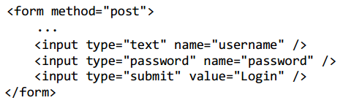
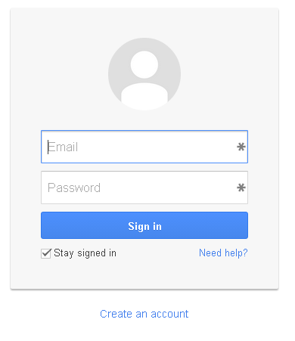
Forms-based Authentication
GET http://localhost/ HTTP/1.1
...
HTTP/1.1 302 Found
Location: /Login.aspx?ReturnUrl=/
...
POST http://localhost/Login.aspx HTTP/1.1
...
username=Mihail&password=1234
HTTP/1.1 302 Found
Location: /
Set-Cookie: .Auth=feEFEeGelkmfwifni32mnf
...

Slide 8
SSO и федеративная идентификация

Slide 9









Federated authentication

Slide 10
Элементы (термины)
Security token
Identity Provider (IP)
Claims / Attributes
Identity protocol
Service provider (SP)
/ Relying Party (RP)
Client credentials
Identity protocol
User/ Client

Slide 11
Протоколы федеративной идентификации
WS-Federation
SAML 1.1/2.0
WS-Trust
OAuth / OAuth2
OpenID Connect
 | Web / REST | SOAP
WS-Federation | ✓ | ❌
SAML 1.1/2.0 | ✓ | ✓
WS-Trust | ❌ | ✓
OAuth / OAuth2 | ✓ | ❌
OpenID Connect | ✓ | ❌

Slide 12
Пример протокола: WS-Federation

Slide 13
WS-Federation
WS-Federation 1.2 (22 May 2009)
http://docs.oasis-open.org/wsfed/federation/200706
Вводит:
Общую федеративную модель (компоненты, операции, топологии, …)
Модель метаданных
Общие механизмы(sign-in, sign-out, attribute service, pseudonym service)
Протоколы обмена сообщениями (WS-Trust – для SOAP) и пассивный (через редиректы) запрос для Web

Slide 14


Sign-in в WS-Federation (Web)
Authentication
OK (200):
<html>
<head>
<title>Working...</title>
</head> ...
Redirect (302):
https://www.mysso.com/tokens?wa=wsignin1.0&
wtrealm=https://www.mysite.com&wct=...
POST: https://www.mysite.com
wa=wsignin1.0&wresult=...
Redirect (302):https://www.mysite.com
Set-Cookies: Session=...
GET: https://www.mysite.com
Cookies: Session=...
GET: https://www.mysite.com

Slide 15
Детали запроса
Request (GET, Redirect)
https://login-prod.epm-sso.projects.epam.com/adfs/ls/wia?
wtrealm=http://epruizhwo249.moscow.epam.com/
&wctx=FDfzEGZ1sJb7R_E1-K38kEkqB
&wa=wsignin1.0
Parameter | Required | Description
wa | + | Действие: wsignin1.0
wtrealm | + | Id ресурса (сервиса), который запрашивает действие
wctx | - | Контекст. Произвольное значение, должен быть возвращен вместе с токеном
wreply | - | URL, куда редиректить после успешного завершения

Slide 16
Детали ответа (форма!!!)
Response: 200 (OK)
<html> <head> <title>Working...</title> </head> <body> <form method="POST" name="hiddenform" action="https://localhost:44335/"> <input type="hidden" name="wa" value="wsignin1.0" /> <input type="hidden" name="wresult" value="&lt;t:RequestSecurityTokenResponse ..." /> <input type="hidden" name="wctx" value="FDfzEGZ1sJb7R_E1-K38kEkqB" /> <noscript> <p>Script is disabled. Click Submit to continue.</p> <input type="submit" value="Submit" /> </noscript> </form> <script language="javascript">window.setTimeout('document.forms[0].submit()', 0);</script> </body> </html>
Parameter | Required | Description
wa | ? | Action: wsignin1.0
wresult | + | Токен, обернутый в тэг WS-Trust RequestSecurityTokenResponse
wctx | - | Контекст (если был в запросе)

Slide 17
Токены

Slide 18
Работа с токенами
Read / Write
Verify
Format
Integrity
Extract data
Expiration
Duplication
Source
Audience
Claims
Keys
Decryption

Slide 19
Форматы токенов
Simple Web Token (SWT)
JSON Web Token (JWT)
Security Assertion Markup Language (SAML)

Slide 20
JSON Web Token (JWT)
HEADER
{
"typ":"JWT",
"alg":"RS256",
"x5t":"fAZA3LPXK5pySBRSrC5o-B89u4M"
}
PAYLOAD
{
"aud":"https://dev.epm-crm.projects.epam.com/",
"iss":"https://login-prod.epm-sso.projects.epam.com/adfs/services/trust",
"iat":1396446848,
"exp":1396533248,
"upn":[
"Mikhail_Tyuzin@epam.com",
"mikhail_tyuzin@epam.com"
],
"primarysid":"S-1-5-21-6361574-293082422-13007618-49611",
"unique_name":"MINSK\\Mikhail_Tyuzin",
"authmethod":"http://schemas.microsoft.com/ws/2008/06/identity/authenticationmethod/windows",
"auth_time":"2014-04-02T13:54:08.269Z",
"ver":"1.0",
"appid":"oauth-client.epm-spf.evbyminsd4719"
}
SIGNATURE
XtgTnNG5Av7oBkvEnphHaoHajpaxesAciQjFW96B_wvfcd0T_pOm6_MR-t86ltaE8F8896f4wEOide25Xx2N8up4bdSdOBhalvJ_FDyHw2wZMCVMJVg3CS3CclE380CRAoV7J

Slide 21
Security Assertion Markup Language (SAML)
<saml:Assertion MajorVersion="1" MinorVersion="1" AssertionID="_9e7c3ef1-35c0-465e-9c9c-2bcabde508b7" Issuer="MySTS" IssueInstant="2013-05-31T10:39:17.306Z" xmlns:saml="urn:oasis:names:tc:SAML:1.0:assertion">
<saml:Conditions NotBefore="2013-05-31T10:39:17.306Z" NotOnOrAfter="2013-05-31T11:39:17.306Z">
<saml:AudienceRestrictionCondition>
<saml:Audience>http://localhost:62535/</saml:Audience>
</saml:AudienceRestrictionCondition>
</saml:Conditions>
<saml:AttributeStatement>
<saml:Subject>
<saml:SubjectConfirmation>
<saml:ConfirmationMethod>urn:oasis:names:tc:SAML:1.0:cm:bearer</saml:ConfirmationMethod>
</saml:SubjectConfirmation>
</saml:Subject>
<saml:Attribute AttributeName="name" AttributeNamespace="http://schemas.xmlsoap.org/ws/2005/05/identity/claims">
<saml:AttributeValue>Mihail Romanov</saml:AttributeValue>
</saml:Attribute>
<saml:Attribute AttributeName="role" AttributeNamespace="http://schemas.microsoft.com/ws/2008/06/identity/claims">
<saml:AttributeValue>Manager</saml:AttributeValue>
<saml:AttributeValue>Administrator</saml:AttributeValue>
</saml:Attribute>
</saml:AttributeStatement>
<Signature xmlns="http://www.w3.org/2000/09/xmldsig#">
<SignedInfo>
<CanonicalizationMethod Algorithm="http://www.w3.org/2001/10/xml-exc-c14n#" />
<SignatureMethod Algorithm="http://www.w3.org/2000/09/xmldsig#rsa-sha1" />
<Reference URI="#_9e7c3ef1-35c0-465e-9c9c-2bcabde508b7">
<Transforms>
<Transform Algorithm="http://www.w3.org/2000/09/xmldsig#enveloped-signature" />
<Transform Algorithm="http://www.w3.org/2001/10/xml-exc-c14n#" />
</Transforms>
<DigestMethod Algorithm="http://www.w3.org/2000/09/xmldsig#sha1" />
<DigestValue>6O88Vp9EFZZHHywnIofwnuYDiKI=</DigestValue>
</Reference>
</SignedInfo>
<SignatureValue>XCytocN3ND5EDCHcgufWSQ98XxL+dprsD0B95AA9RbRKsTyDBS ….</SignatureValue>
<KeyInfo>
<X509Data>
<X509Certificate>MIIBuzCCAWmgAwIBAgIQAq6R42QBqJ1oe …</X509Certificate>
</X509Data>
</KeyInfo>
</Signature>
</saml:Assertion>

Slide 22

Подведем итог…
Механизмы
Встроенные в HTTP
На базе HTTP
Применяемые
На основе форм
SSO
Протоколы и токены в SSO
WS-Federation, OAuth2, OpenID Connect
JWT, SAML (уже редко)

